Slide 1
Predicting the Ideal Location for a New Restaurant in Baton Rouge, Louisiana
Olevia Sharbaugh
July 6, 2020

Slide 2
Introduction to the Problem
Baton Rouge is one of the most culturally diverse cities in the United States and has made a name for itself
It is slowly transforming into a global hub of business and commerce
Baton Rouge, and Louisiana as a whole, is known for its Cajun cuisine and it is a big part of their culture as a whole
Food tourism is a very large industry in this state which makes entering into this competitive market in Louisiana difficult, and necessitates further analysis

Slide 3
Introduction to the Problem
Those interested in opening a restaurant in Baton Rouge must consider:
the population breakdown of the city
the presence of any Farmers Markets or anything of the like to obtain ingredients
the presence of population drawing venues such as bars, movie theatres, or parks
the presence and identity of competitors in that location as well as their cuisine
the presence of any untapped or saturated markets

Slide 4
Data
Data on Baton Rouge and its many neighborhoods
includes the name of the neighborhood, the community in which it resides, the population of people in each neighborhood, and the latitude and longitude coordinates of the neighborhood
obtained from an official Baton Rouge website
latitude and longitude coordinates of each neighborhood were added manually
there are 9 communities and 45 neighborhoods
Foursquare data to determine the best location to open a brand new restaurant.
This data will help to determine other venues in Baton Rouge, details about them, and their location.

Slide 5
Methodology
This analysis was completed using many python libraries including; numpy, pandas, json, nominatim, requests, matplotlib, KMeans, and folium.
The first step in this analysis was to confirm the amount of communities and neighborhoods, and plot them on a map using folium.
I then used my Foursquare credentials to create a function that returned all nearby venues for the neighborhoods in Baton Rouge,
There were a total of 119 unique venues located in Baton Rouge and created a dummy variable for each of these.
I was then able to find the ten most common venues in each neighborhood and put this information into a pandas dataframe.
Lastly, I began to cluster the neighborhoods into five different clusters and examined those clusters in more detail by looking at the most common venues of each, and the neighborhoods with the most promise when considering opening a new restaurant.

Slide 6
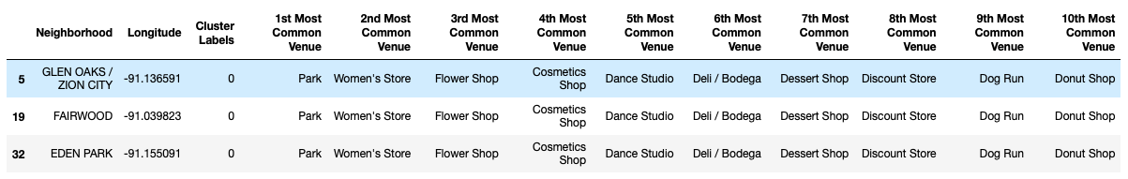
Results
Cluster 1
Cluster one demonstrates surprising homogeneity among the neighborhoods that belong to it.
Their first five most common venues in descending order are a park, a women’s store, a flower shop, a cosmetics shop, and a dance studio.
None of these top five include a restaurant, and in fact, there is not a legitimate restaurant listed in their top 10 most common venues, but rather a deli, dessert shop, and donut shop.

Slide 7
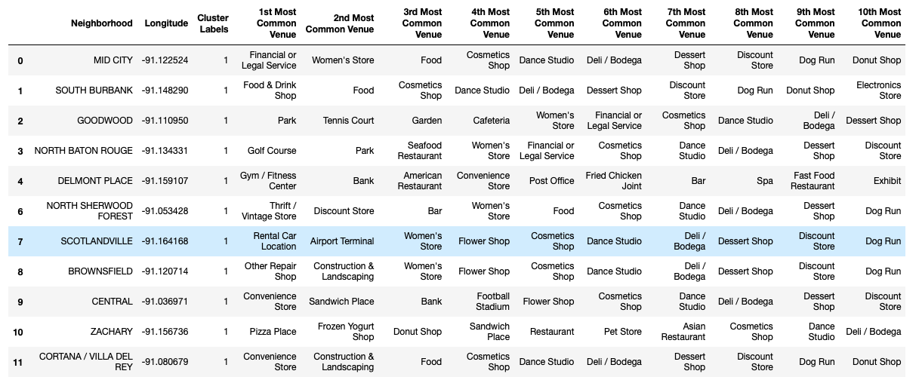
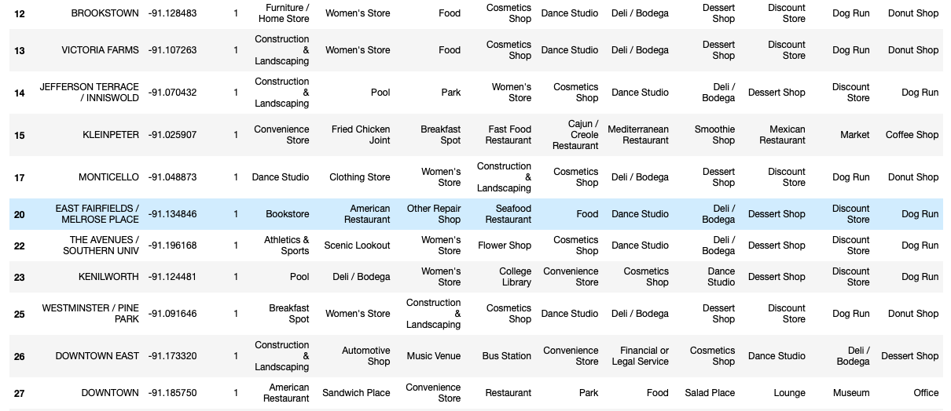
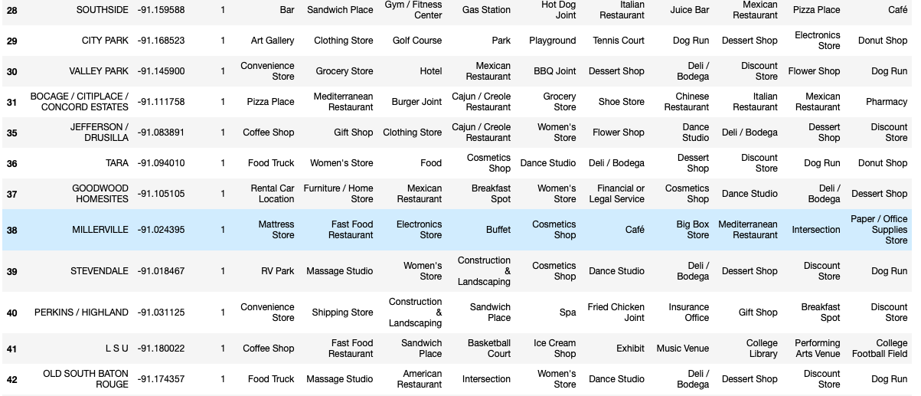
Results
Cluster 2
Cluster 2 is much larger than cluster 1.
Only six of the 44 neighborhoods located in this cluster have a restaurant listed as their number 1 most common venue, but a large majority include a restaurant of some capacity in their top five most common venues.

Slide 8
Results
Cluster 3
Cluster 3 is the smallest cluster and includes home service, women’s store, food, cosmetics shop, and dance studio as its most popular venues.

Slide 9
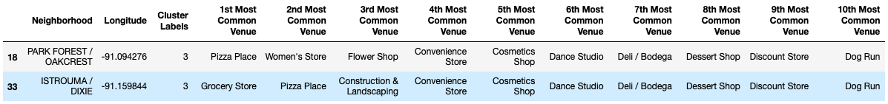
Results
Cluster 4
Cluster 4 has only two neighborhoods located within it, but their top five most common venues include a pizza place which could provide competition to any restaurants interested in opening in this area

Slide 10
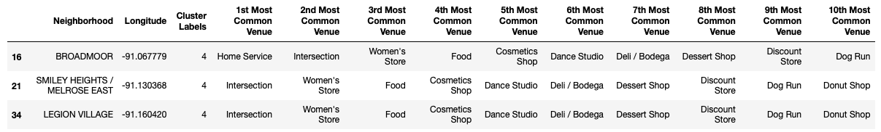
Results
Cluster 5
The final cluster includes only 3 neighborhoods whose top five most common venues include a “food” venue.
This cluster also lists the most common venue for two out of the three neighborhoods as an intersection.

Slide 11
Discussion
farmers markets do not appear on any neighborhoods top ten most common venues, therefore, the presence of farmers markets in Baton Rouge neighborhoods cannot be considered
Examining Cluster 5,
only three neighborhoods located in this cluster and two of those three have an intersection listed as their most common venue.
an intersection is not ideal as a population drawing venue.
They have a “food” venue listed in their top five most common so this cluster may already be saturated.
The neighborhoods also have below average population counts at 5966, 4430, and 1624.
The average population for neighborhoods in Baton Rouge City is around 7,065.
Due to these factors, opening a restaurant in the neighborhoods located in cluster 5 is not ideal.

Slide 12
Discussion
Cluster 4
there are only two neighborhoods located in this cluster and the top venue for one of these is a pizza place and it is the second most common venue for the other.
There are no population drawing venues located in the top ten most common venues of this cluster.
They have a various food service venues located in their top ten so this cluster may also be saturated.
The neighborhoods also have below average population counts at 6857, and 4152.
Due to these factors, opening a restaurant in the neighborhoods located in cluster 4 is also not ideal.

Slide 13
Discussion
Cluster 3
has only one neighborhood whose top venues include “food” and no population drawing venues.
It also have a very small population of only 3916.
Due to these factors, opening a restaurant in the Pollard neighborhood located in cluster 3 is not ideal.

Slide 14
Discussion
Cluster 2
the largest cluster with a total of 44 neighborhoods.
a large majority include a restaurant of some capacity in their top five most common venues.
Many of the neighborhoods located in this cluster include population drawing venues like bars, parks, scenic lookouts, art galleries, and many more.
The population of many of these neighborhoods is also way above the average, though there is much variation.
When considering all of these factors together it is difficult to say with certainty if any of the neighborhoods in cluster 2 are viable to the opening of a new restaurant.

Slide 15
Discussion
Cluster 1
Cluster 1 contains three neighborhoods who all contain the same top ten most common venues.
Their first most common venue is a park which could certainly draw populations to these neighborhoods.
None of the top five most common venues of these neighborhoods include a restaurant, and in fact, there is not a legitimate restaurant listed in their top 10 most common venues, but rather a deli, dessert shop, and donut shop.
Lastly, the average population of all of the neighborhoods located in cluster 1 is 600 above the average population of Baton Rouge.
Due to these factors, opening a restaurant in the neighborhoods located in cluster 1 is seems to be the most ideal of any other neighborhoods.

Slide 16
Conclusion
Louisiana is a beautiful and culturally diverse state and it’s capital, Baton Rouge, is an up and coming financial powerhouse with many new business opportunities developing every day.
It’s food tourism also makes it an ideal place to open a restaurant
However, there is intense competition in this market that make additional analysis imperative for a new business’ success
After thorough analysis, I conclude that Cluster 1 which includes Glen Oaks / Zion City, Fairwood, and Eden Park would be the best place to open an new restaurant in Baton Rouge.
These neighborhoods have population drawing venues located among their top ten most common venues, no legitimate restaurants in their top ten, and a population that could sustain a business in the long run.
Though Cluster 2 also showed promise in its large population and many population drawing venues, it had a relatively saturated restaurant market that could present problems at the beginning of the business venture.
Therefore, my analysis provides evidence that opening a restaurant in Glen Oaks / Zion City, Fairwood, or Eden Park would prove most successful.

